Slide 1
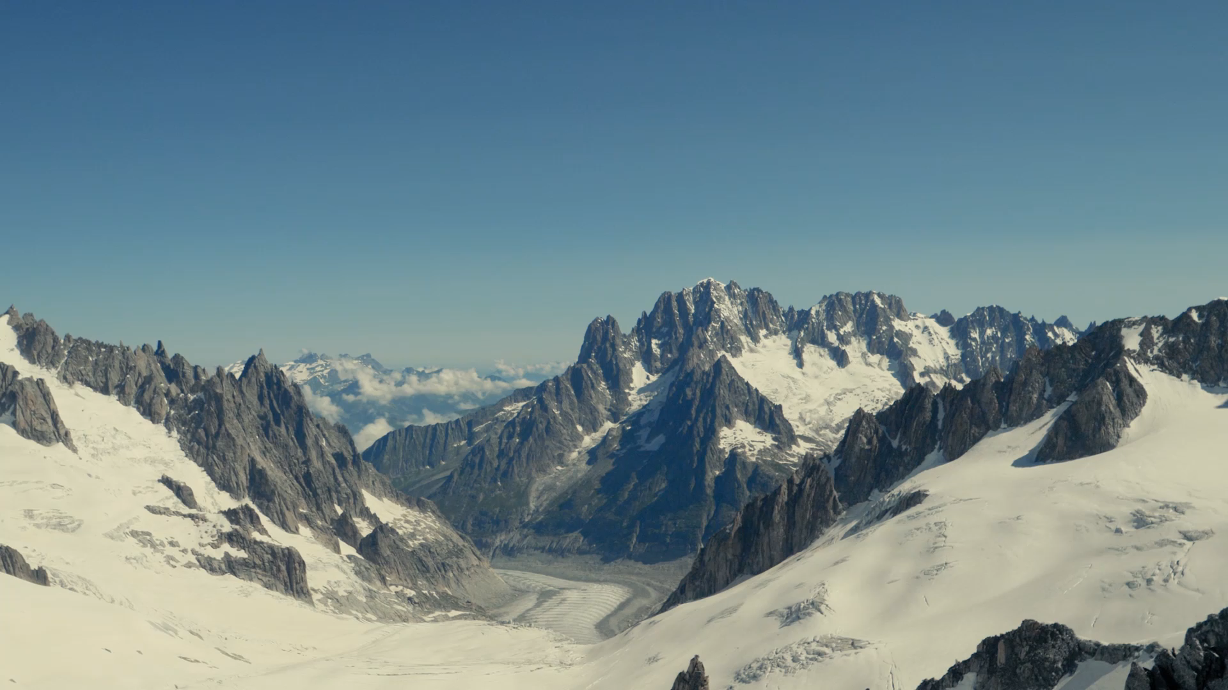
Big Mountain Presentation
By: Blake Hulett

Slide 2
Market Price of Tickets
To this point, Big Mountain has been using a simple average method to estimate the market price of tickets.
We have created a model that predicts ticket price based on available facilities.
Using this model, we have 3 sound recommendations for future action by Big Mountain’s executive team.

Slide 3
Recommendations
Increase ticket price to $95
Add a 150ft run without additional snow cover
Permanently close down the least used run

Slide 4
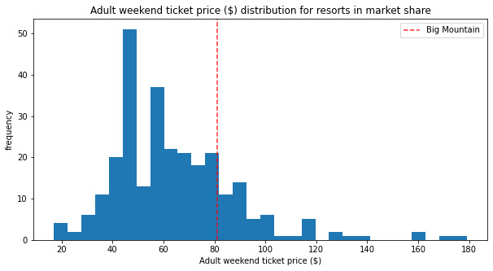
Ticket Price Increase
Where Big Mountain sits currently:
Our model’s expected price function
Big Mountain’s current facilities justify the increase.
No additional investment required

Slide 5
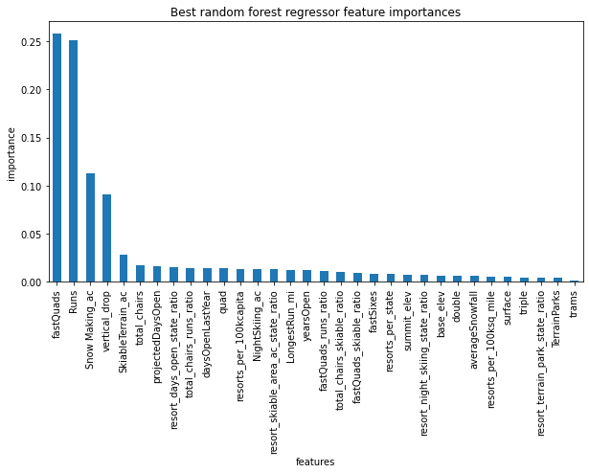
Scenario 2 Implementation
Big Mountain should add the 150ft run without additional snow cover
Big Mountain’s current facility dominance
High snowmaking acreage already, no additional impact
Best way to manage costs while increasing revenue

Slide 6
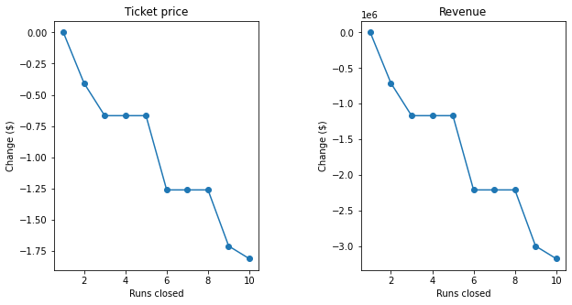
Scenario 1 Implementation
Big Mountain should close down its least used run
No impact on current revenue to close 1
No revenue difference 3-5 & 6-8
Cost of maintaining these runs is a huge factor

Slide 7
Clearer Picture
Our model provides greater sophistication than simple average guessing
We recommend raising the ticket price and implementing scenarios 1 & 2
This model can be used to evaluate future investment decisions as well

